Slide 1
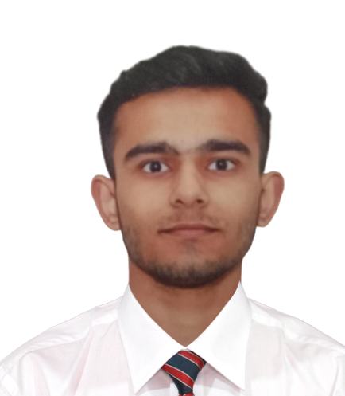



Harsh Chaudhary
Bachelor in Technology
Information Technology : 2018 -2022
Analyst/Software Engineer
Skills
Java 8 /J2EE | Java Basics, OOPS, Generics, Collections, Arrays, Loops, Lambda Exp, Stream API Junit, Servlets & Exception Handling.
Spring core | IOC & Dependency Injection, Autowire
Spring REST | REST controllers, Implementation of GET, POST, PUT & DELETE, Bean Validation, Testing Services, Controller & Repository layer
Spring Data JPA | Implement DAO layer using spring Data repositories, Transaction Management
Spring Boot Microservices | Microservices Architecture, Spring Boot Starters, annotations, Messaging Service, Swagger API documentation
Spring Cloud | Eureka Server & API Cloud Gateway
React | Components, Routing, Event handling, Axios.
Database | MongoDB No Sql Basics My SQL RDS Basics
UI Tech | HTML 5 & CSS 3,JavaScript Reusable templates, Optimized UI Designed
Tools | Git, Postman, Maven, IDE
Devops | CI/CD, Jenkins configuration, Build Pipelines, Docker
Add On skills | Effective Communications, Fast Learner, Team Management & Punctual.
Bangalore
harsh.chaudhary@capgemini.com
+91 9990766037
A4
Full Stack Developer
Hands on experience in creating microservices with Springboot, Spring Security, Spring Cloud API Gateway, Eureka server, load balancing and logger.
Proficient in creating Single page Web Application in ReactJs with Components, Routing, Axios, Bootstrap CSS, Authentication and Event Handling.
Hands on experience in implementing polyglot architecture with ReactJs & spring boot
Experience in creating documentation with swagger and unit testing using Junit, RabbitMQ for internal messaging(Notifications), SMTP for Email Service.
Development experience in creating docker compose files, docker images and pushing to Docker Hub.
Understanding of AWS Cloud environment
Certification :
● AWS Certified cloud practitioner
Projects :
● ONLINE HOTEL MANAGEMENT SYSTEM
Completed end to end case study of Hotel Management System along with JWT authentication, Swagger and payment gateway using Paytm, RabbitMQ, SMTP, Logger, responsive UI with bootstrap CSS and React used for frontend.
● Criminal Face Identification System
An application created using face recognition and Machine
learning and it is used to identify a criminal just by looking
and its face and shows all the details related to that criminal.
● HTML & CSS course from BoltIot
Completed this course and Designed responsive website using HTML5 CSS3 .
● CAMP Training In Capgemini on JEE with Devops and AWS
Check out my work on GitHub & Video Profile

